Slide 1
Data Product Manager Nanodegree
Applying Data Science to Product Management
Final Project: Developing an MVP Launch Strategy for a Flying Taxi Service

Slide 2
Welcome to your first week at Flyber

Slide 3


Slide 4
In this project, you will apply the skills acquired in this course to create the MVP launch strategy for the first flying car taxi service, Flyber, in one of the most congested cities in America -- New York City.
You are responsible for bringing the first flying car taxi service to market by analyzing data and building a product proposal.

Slide 5
You will need to use the SQL workspace provided in the Classroom, and Tableau Public, in order to successfully complete the project.
You’ll present your answers, findings, and insights in the Answer Slides found in this deck. Feel free to include any additional slides, if needed.

Slide 6
Section 1: Data Exploration

Slide 7
Back to the basics of product management, identify your customer and their pain points:
What are taxis used for?
What are the characteristics of the users that leverage them?
What are existing pain points with taxis?
What are the existing pain points with digital ride-sharing services?

Slide 8
Answer Slide
What are taxis used for?
Taxis are private vehicles rented for a short periods of time to provide transportation to desired destination for a fee.
What are the characteristics of the users that leverage them?
Users have disposable income to pay a premium for the reduced transit time and personal comfort in a private ride as compared to communal modes of transportation like buses and subways.
What are existing pain points with taxis?
With many taxis offering their services for premium fare, roads inevitably becomes congested, more damage to roads requiring repairs and hence increase transit time, road closures and costs for repairs.
What are the existing pain points with digital ride-sharing services?
Availability of hireable car depends on time of day (way less during early hours of the day compared to typical business hours) and costs fluctuate depending on demand (surge pricing). Safety is also not issue as these drivers are not licensed.

Slide 9
What user improvements do you hypothesize a flying taxi service would have over the existing state of taxis today?
What market improvements do you hypothesize a flying taxi service would have the existing taxi service industry & physical road infrastructure today?

Slide 10
Answer Slide
Users of flying taxi service may benefit from the better transit time as traffic jams and road closures might be avoided and distance travelled reduced as a more direct path can be journeyed.
Existing taxi service industry would expand to the skies which will require rigorous regulations and licensing from the FAA, limiting the entry of freelance ride-sharing competitors who had disrupted the traditional taxi service, thereby giving them more control and dominance in this particular mode of transport.
With fewer taxis and even ride-sharing private cars on the road as more travelers choose the flying taxis for speed and convenience, roads should become less congested and be of better condition, requiring fewer repairs and road closures. If road usage dropped to an significantly low level, sections of roads can be converted to pedestrian only, giving room for more shops and parks, encouraging more foot traffic and commerce.

Slide 11
Upload this dataset into Tableau Online.
Ensure the fields are parsed correctly; field headers are included in the first row of the CSV. Let’s begin exploration!

Slide 12
Acquire a high-level understanding of the granularity and scope of the dataset, to inform the basis for your analyses:
How many records are in the dataset
What does each record represent?
What is the primary key?
What date range is your dataset bound to?
What are the geographical bounds of this dataset? Is it limited to Manhattan, or is Brooklyn, Queens, Staten Island, the Bronx, and New Jersey included? Where are most of the data points centralized at? Are there outliers?

Slide 13
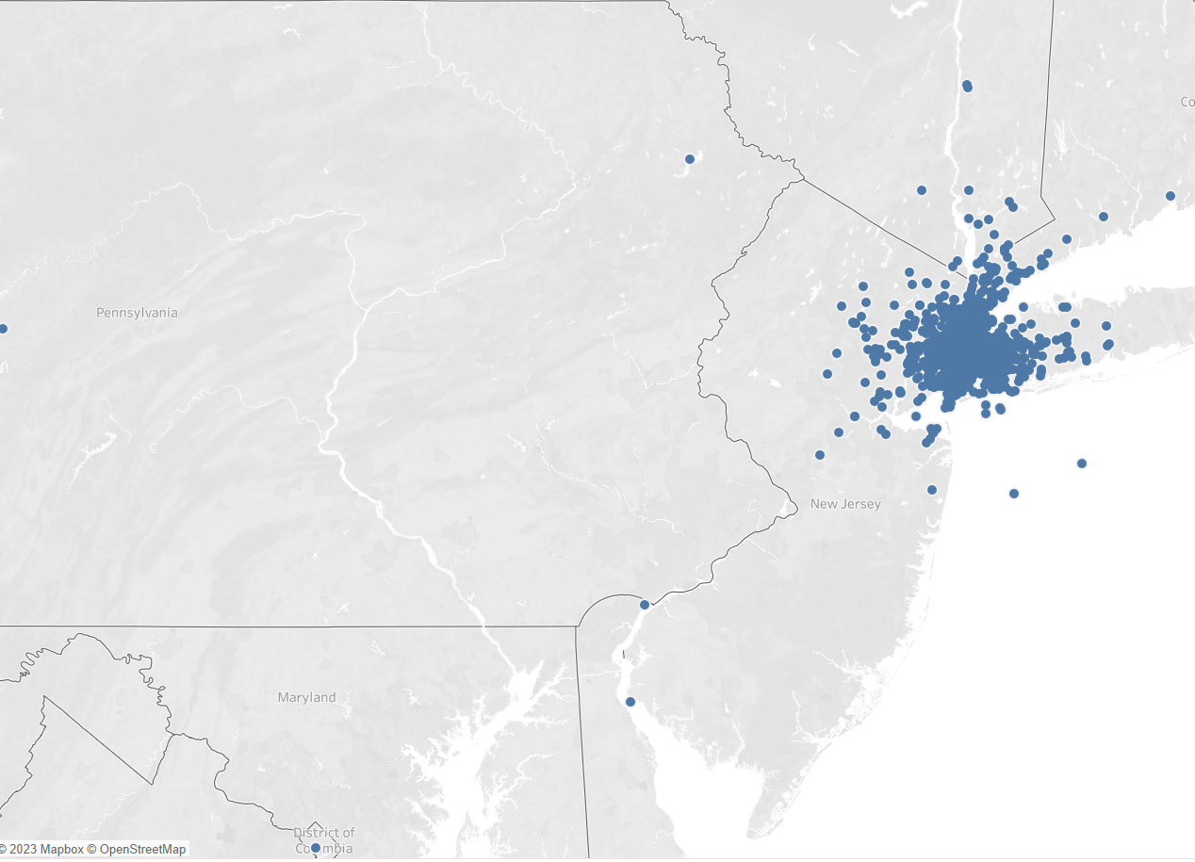
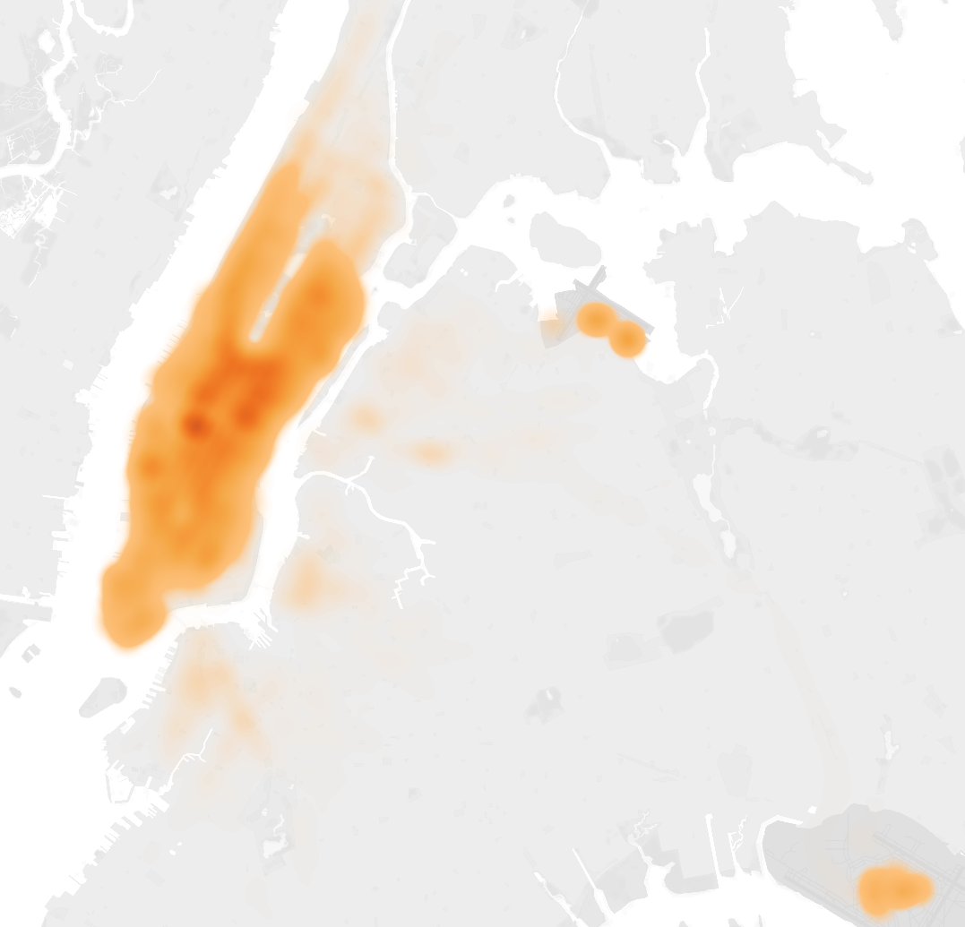
Answer Slide
How many records are in the dataset
1,048,468
What does each record represent?
Each record represent a taxi ride with taxi vendor id, pickup and dropoff times and locations, number of passengers, trip duration and distance.
What is the primary key?
Primary key is the Id for each trip.
What date range is your dataset bound to?
Data ranged from January 1 2016 to June 30 2016
What are the geographical bounds of this dataset? Is it limited to Manhattan, or is Brooklyn, Queens, Staten Island, the Bronx, and New Jersey included? Where are most of the data points centralized at? Are there outliers?
Centralized to Manhattan and fewer in Brooklyn, Bronx and Queens with the exception of JFK and LGA airports. There’s also outliers in PA, NJ, DC and even in the ocean.

Slide 14
You notice that the dataset does not contain explicit data points out-of the-box, we’ll need to enrich the dataset with relevant fields:
You notice that ride price is not included, but figure it could be derived. Based on information about New York taxi prices gleaned from the internet, create a calculated field called `price` using the `duration`, `distance`, and `passenger count` fields.
You hypothesize your target users will be those who take a relatively longer time getting to a destination that is relatively close, due to heavy traffic conditions and/or limitations to physical road infrastructure. To be able to analyze where this is happening, you will need to create a calculated field called `distance-to-duration ratio`.

Slide 15
Let’s understand the scope and distribution various dimensions within the dataset. Calculate the average, median, and the first & second standard deviation of the mean for the following measures:
duration
distance
passenger counts
duration-to-distance ratio
price

Slide 16
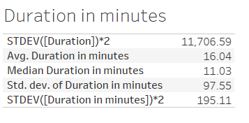
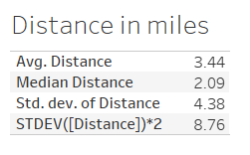
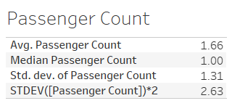
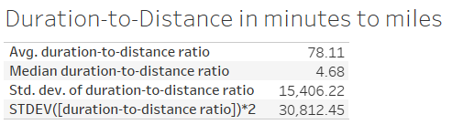
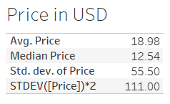
Answer Slide
Price estimated according to https://www.gobytaxi.com/north-america/united-states/new-york/new-york-city
Base fee = $4.30, Price per miles = $2.99, Price per hour = $32.50, no surcharge with more passengers.

Slide 17
Flying cars may have to have to be a lower weight for efficiency & take-off. Or you may just decide to leverage mini-copters for your initial MVP.
Create a histogram that visualizes the number of total rides grouped by passenger counts to analyze the potential market volume of low passenger pickups (1-2 passengers).

Slide 18
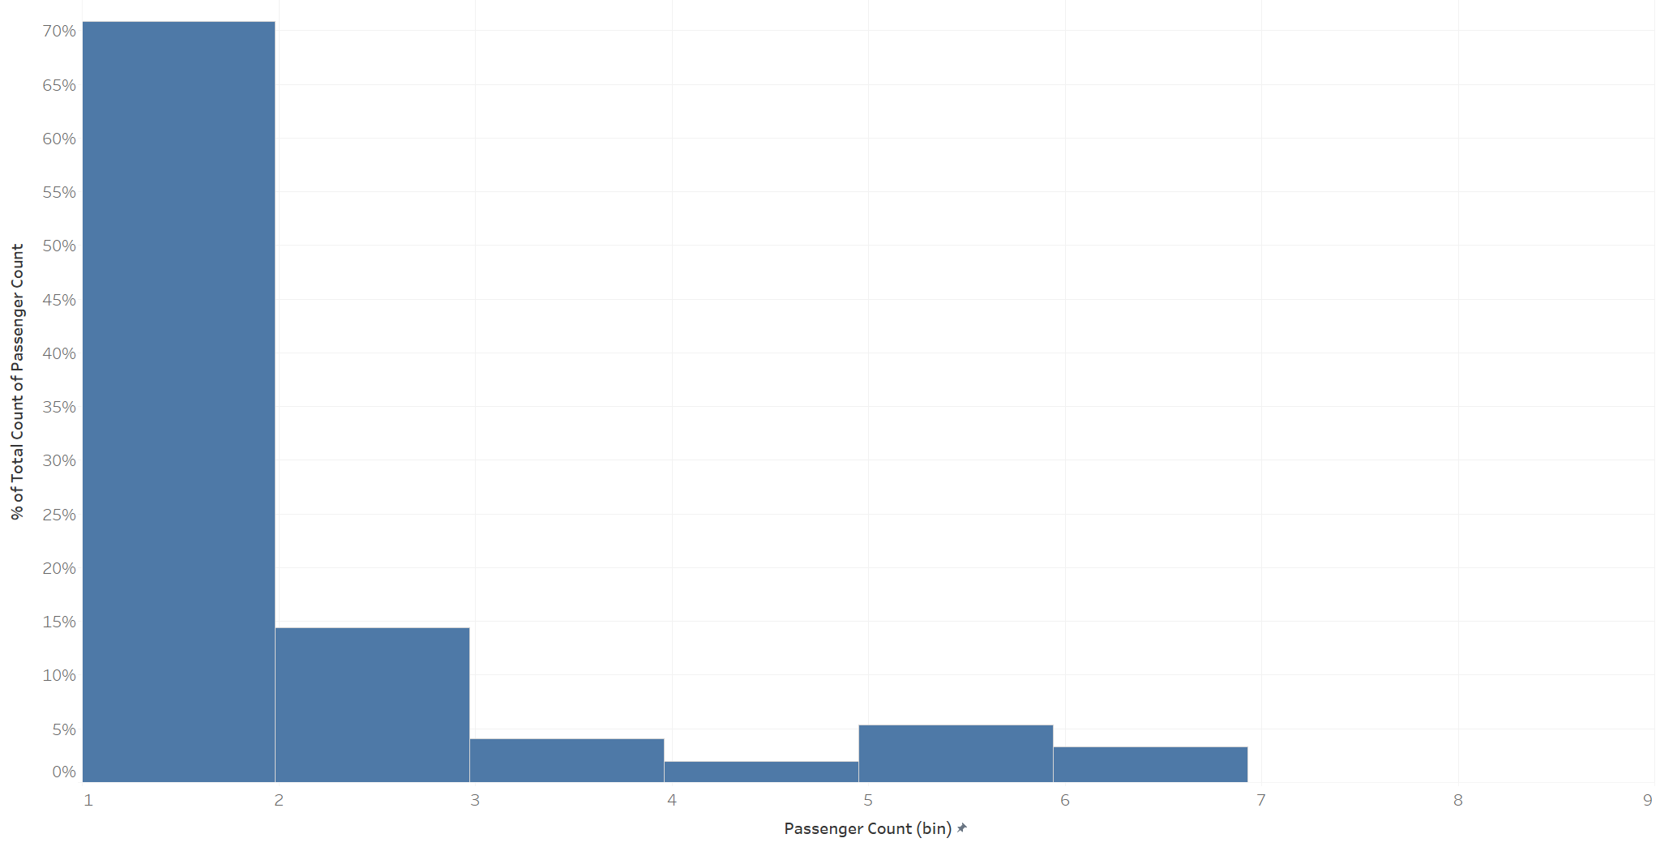
Answer Slide
Out of the over 1 million taxi rides, 70% had 1 passenger only.
14% had 2 passengers. Even less with lower than 5% for 3 or more passengers.
Most taxi passengers are just solo, making weight limitations with flying taxis not a significant problem.

Slide 19
For the initial MVP launch (& most likely GA), we have a finite amount of monetary resources to build Flyber pick-up / drop-off nodes. We’ll need to be strategic on where we’ll place them:
Which neighborhoods/zip codes tends to experience a relatively higher density of pick-ups?
Which neighborhoods/zip codes tends to experience a relatively higher density of drop-offs?
Which neighborhoods/zip codes tends to have the highest duration-to-distance ratios, based on pick-up?
Which neighborhoods/zip codes tends to have the highest duration-to-distance ratios, based on drop-off?
For any of the neighborhoods identified, are there any potential areas within the neighborhood that are optimal for flying taxi pick-up / drop-off? What makes them suitable?

Slide 20
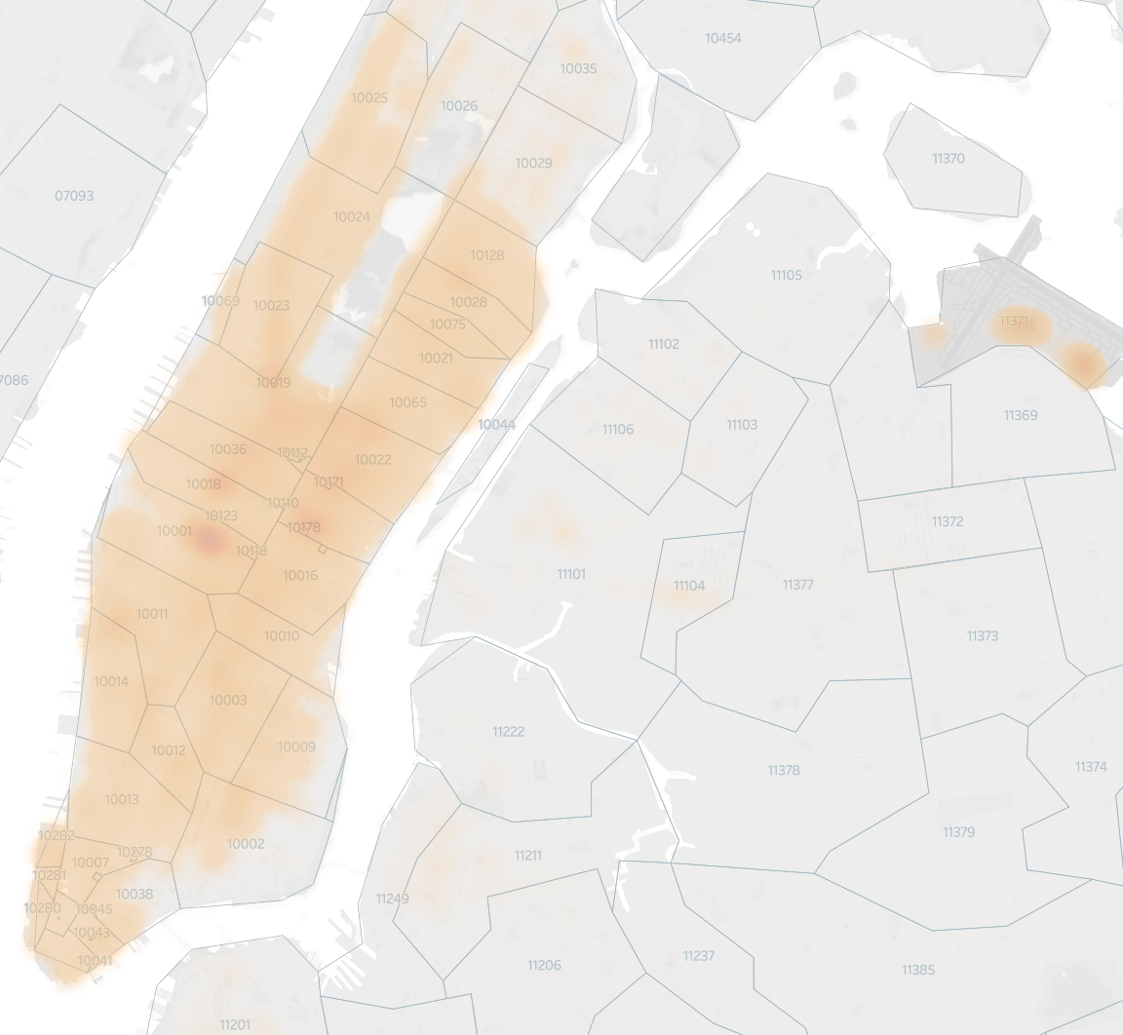
Answer Slide
Which neighborhoods/zip codes tends to experience a relatively higher density of pick-ups?
Zip codes 10001, 10018, 10178, 10036, 10022, 10110.
Along with LGA and JFK airports.

Slide 21
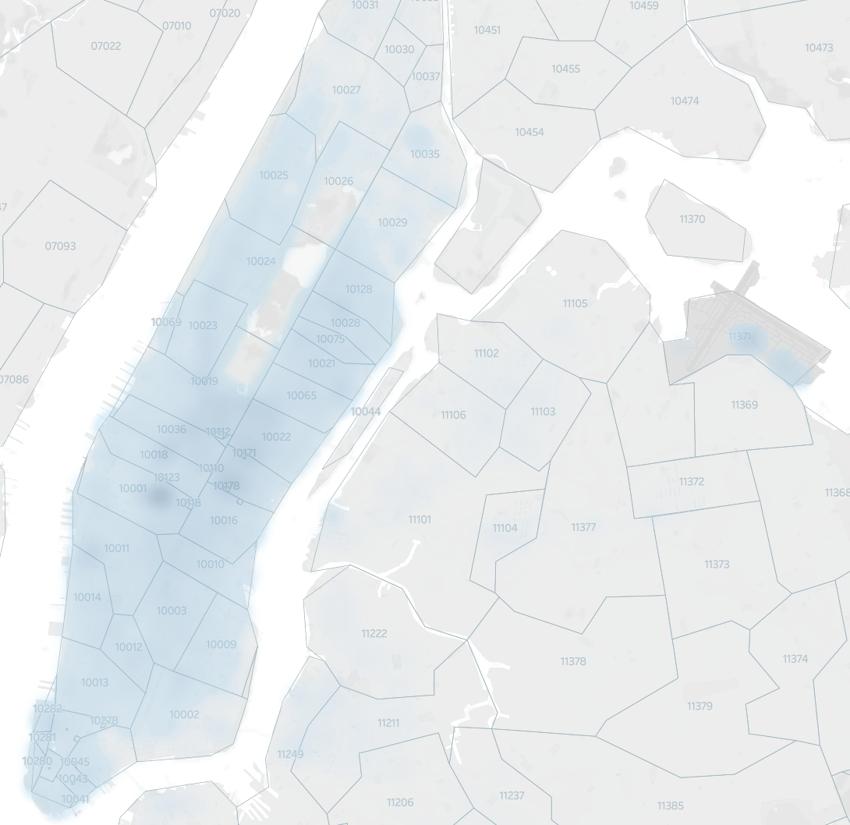
Answer Slide
Which neighborhoods/zip codes tends to experience a relatively higher density of drop-offs?
Similar to pickup, zip codes 10001, 10018, 10178, 10036, 10022, 10110.
Along with LGA and JFK airports.

Slide 22
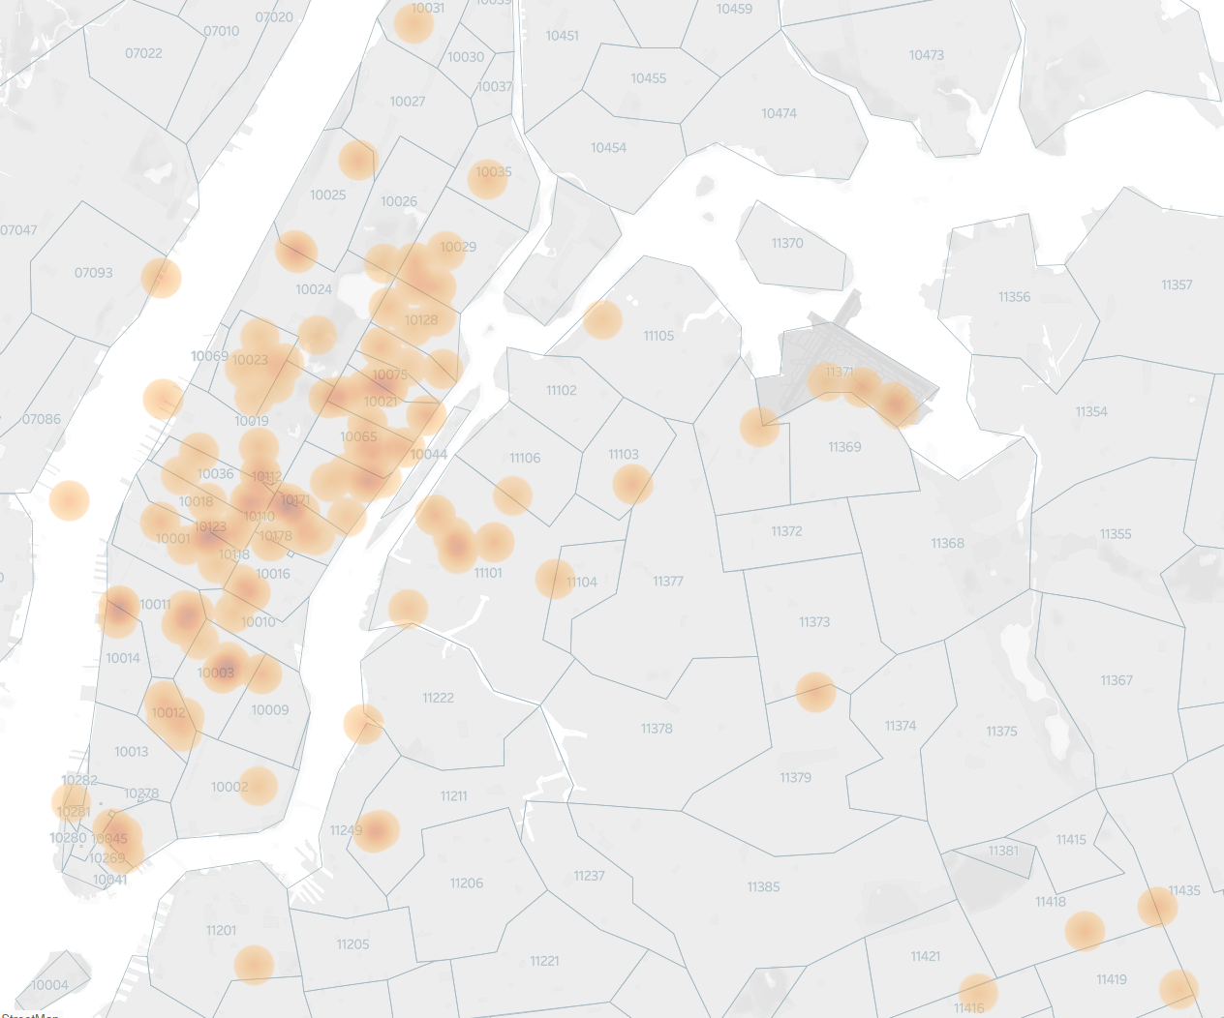
Answer Slide
Which neighborhoods/zip codes tends to have the highest duration-to-distance ratios, based on pick-up?
Outliers in PA, NJ, DC and in ocean are removed.
Limiting the duration-to-distance ratios to between 50 and 100k, majority are concentrated in zipcodes 10171, 10123, 10003, 10110.
Along with LGA and JFK airports.

Slide 23
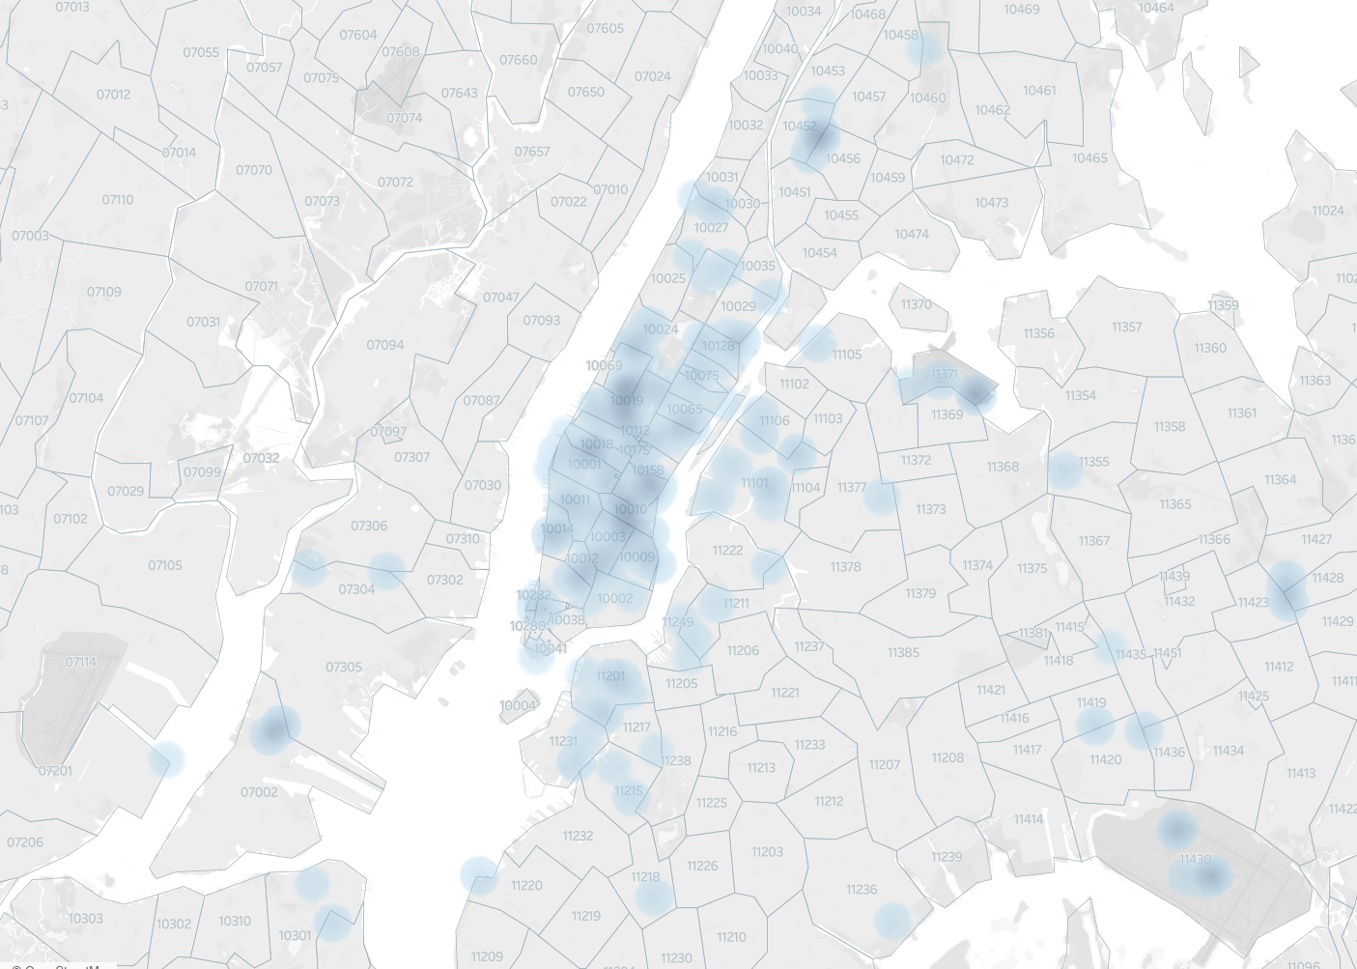
Answer Slide
Which neighborhoods/zip codes tends to have the highest duration-to-distance ratios, based on drop-off?
Outliers in PA, NJ, DC and in ocean are removed.
Limiting the duration-to-distance ratios to between 100k and 500k, majority are concentrated in zipcodes 10019, 10158, 10010, 10018.
Also LGA and JFK airports too.

Slide 24
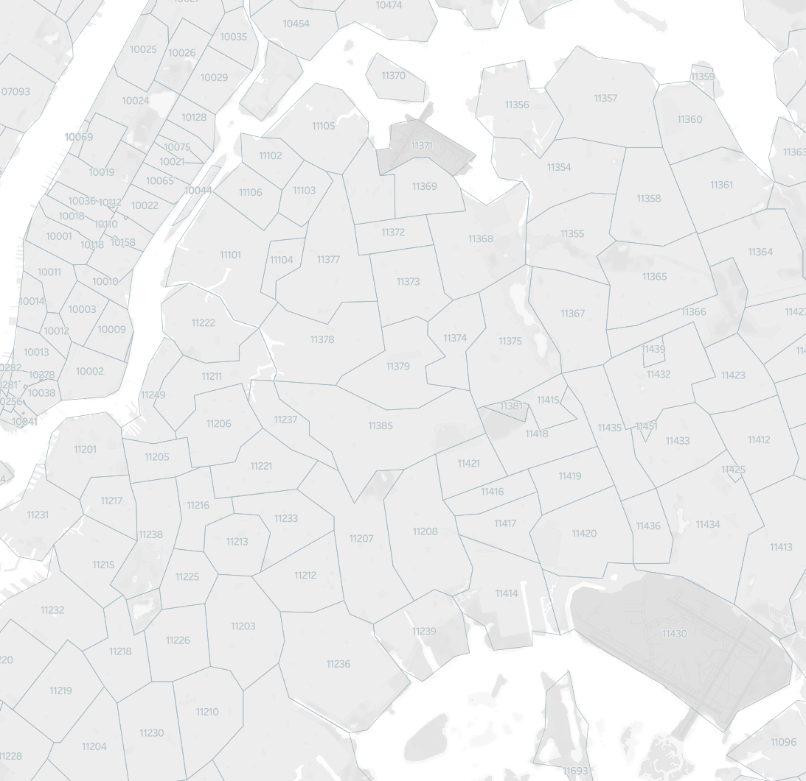
Answer Slide
For any of the neighborhoods identified, are there any potential areas within the neighborhood that are optimal for flying taxi pick-up / drop-off? What makes them suitable?
Common areas for both pickup and dropoff are 10001, 10018, 10178, 10036, 10110, as well as the JFK and LGA airports.
These areas have the most demand in middle of Manhattan and airports and spend longer time to commute relative to distance.

Slide 25
It may not make operational sense to have the service running 24/7, for now.
What times throughout the day experience relatively higher volumes of ride pick-ups?
What days throughout the week experience relatively higher volumes of ride pick-ups?
Pinpoint any periods throughout the year that experience trend fluctuation or seasonality around ride pick-up volumes. This will help us in our post-launch analyses to determine if any spikes or dips were influenced by seasonality or through actual feature adoption/regression.

Slide 26
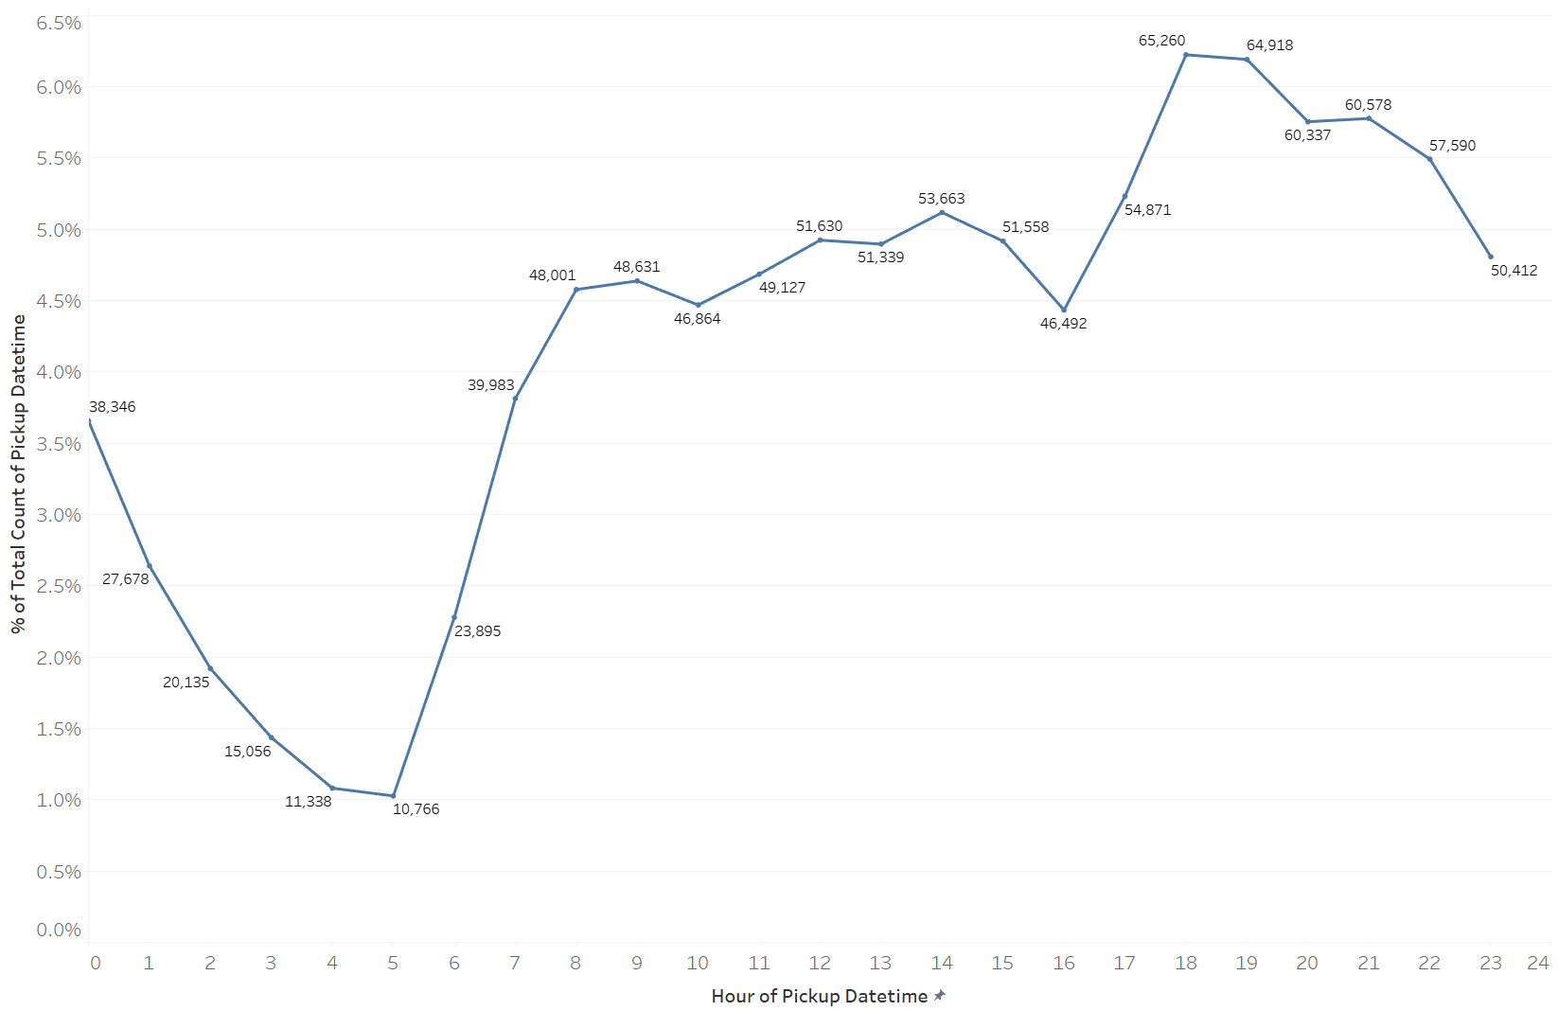
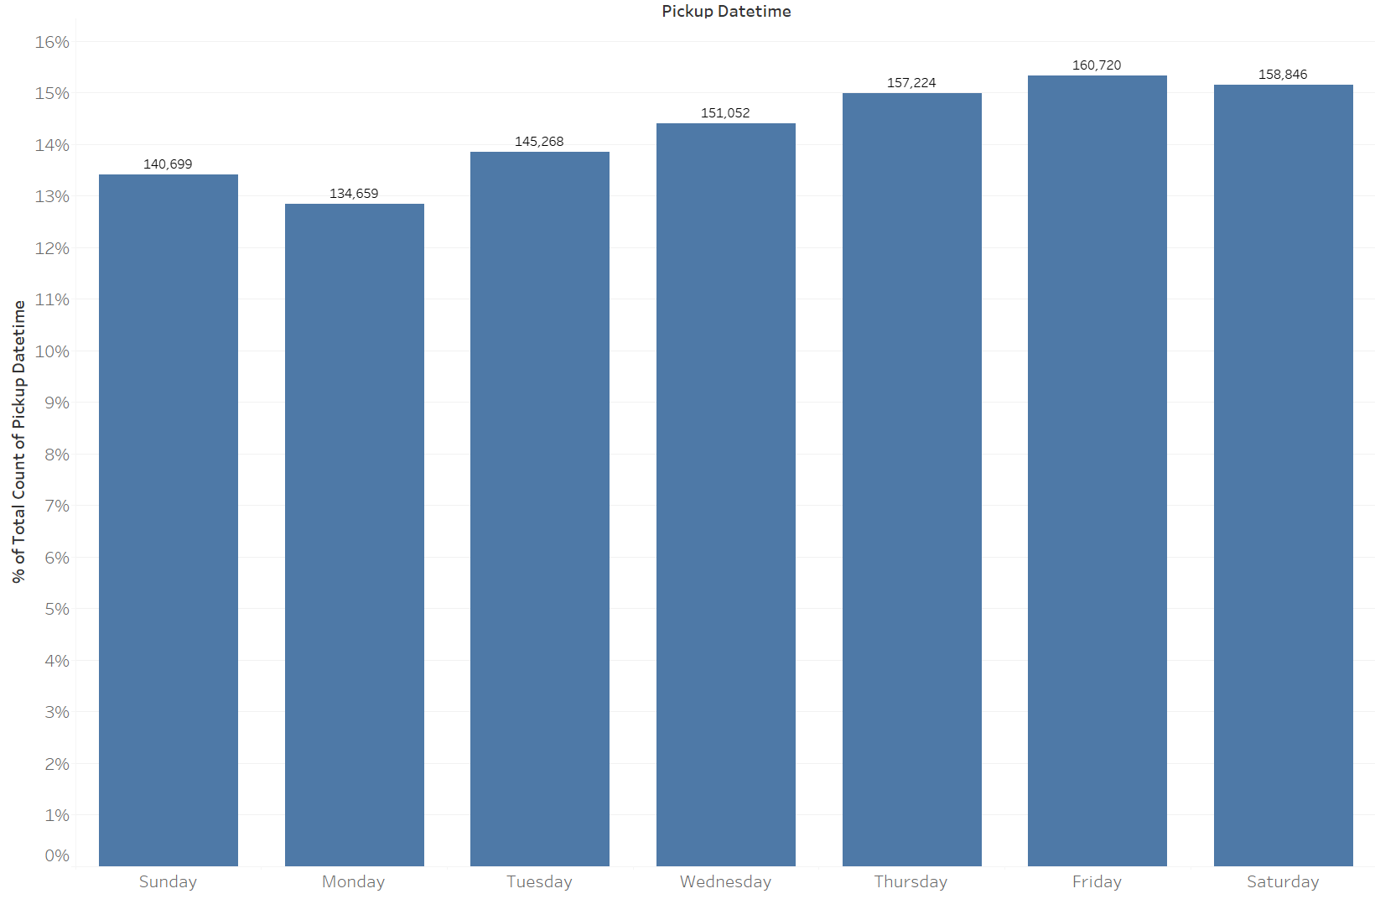
Answer Slide
Higher volumes after 5pm to 10pm. Drops significantly from 11pm to5am after which it start picking up as people start going to places for the new day.
Highest on Friday and Saturday as people are out and about trying to get to their destinations. Lowest on Monday and Sunday as people tend to be home, although the difference in ride volume isn’t large.

Slide 27
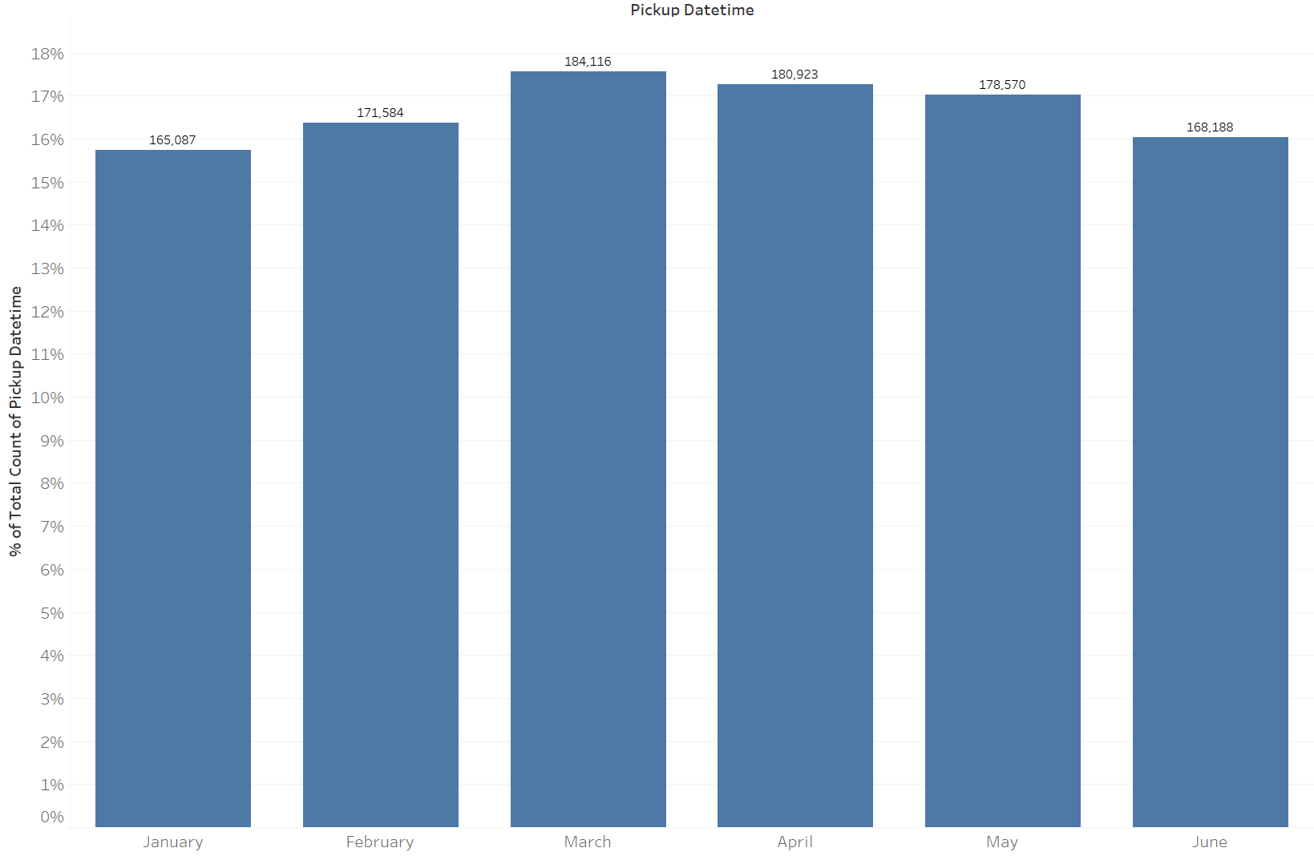
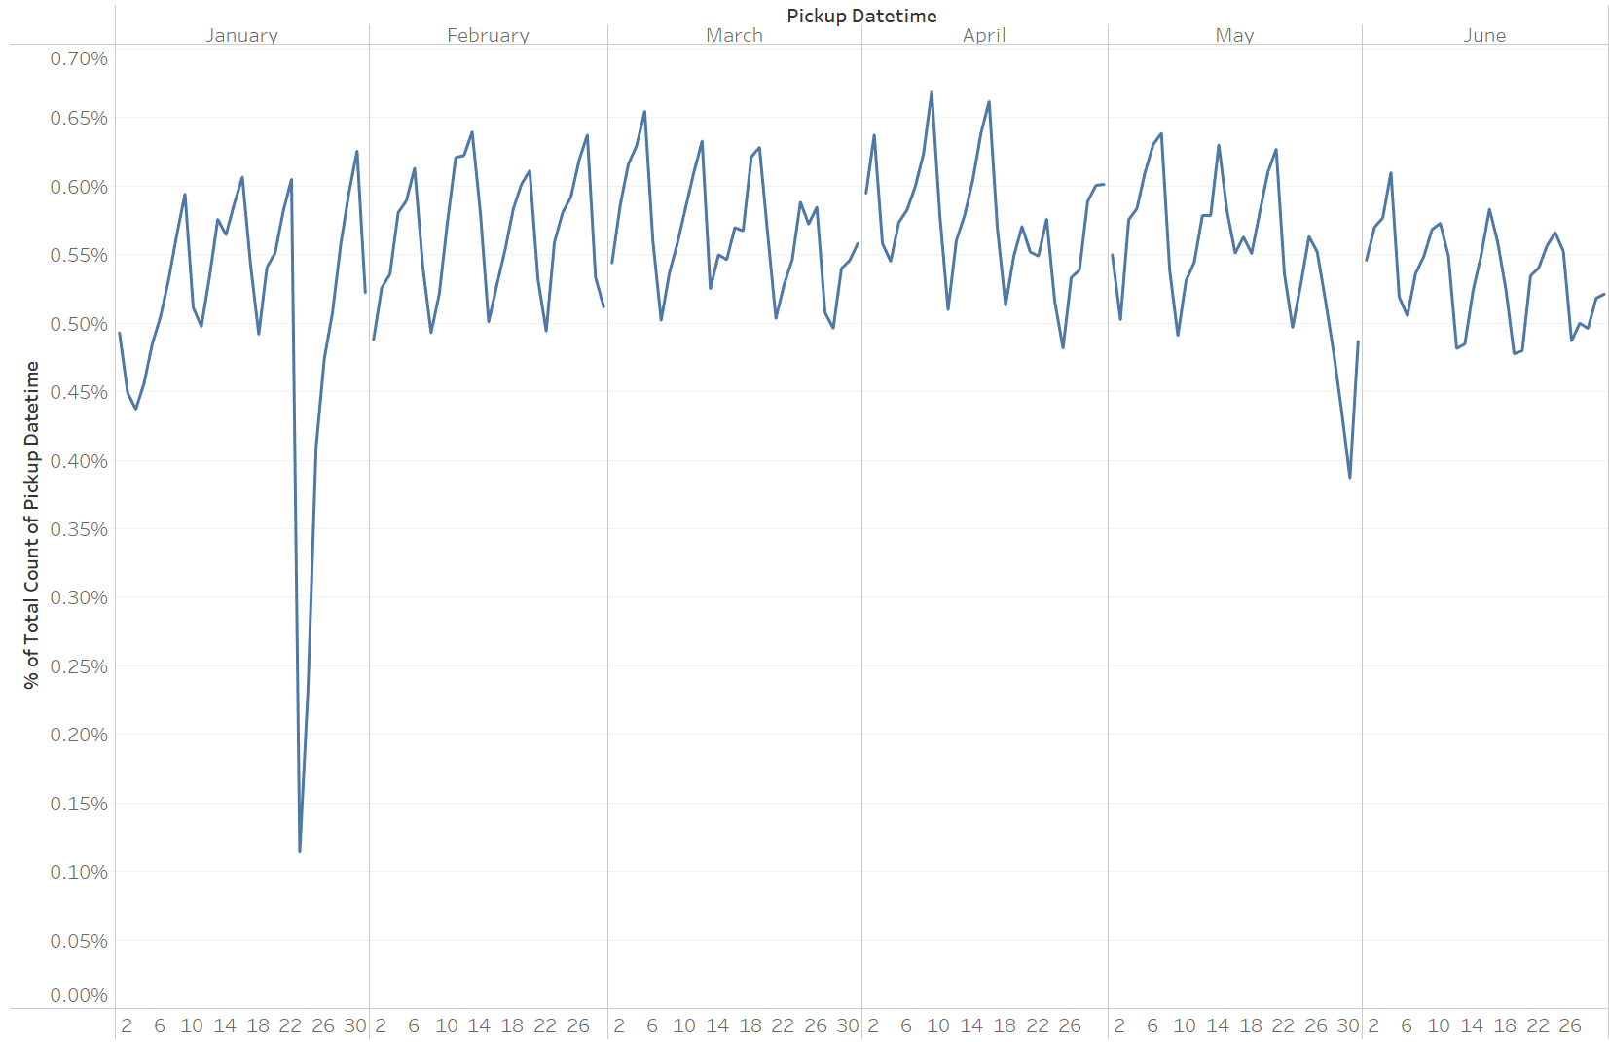
Answer Slide
No large fluctuations in ride volumes from Jan to Jun 2016.
Highest was in March and lowest in Jan.
Daily fluctuations per month cycles with lowest for Monday, raising each day to peak on Friday before dropping again. Note the sharp drop on Jan 23 2016 due to travel ban in NYC due to severe weather. May 30 2016 is a public holiday Memorial day, businesses are mostly closed.

Slide 28
You and the user research team ran a quantitative survey on existing taxi and/or rideshare users in New York City to determine sentiment around potentially using a flying taxi service.
Dive into the survey results dataset in order to extract insights from explicit feedback.
Upload this dataset into Tableau Online or a SQL database (the classroom contains a workspace with the data for you as well).

Slide 29
Ensure the fields are parsed correctly, field headers are included in the first row of the CSV.
Question schema:
Q1 - What is your email?
Q2 - What gender do you identify as?
Q3 - What is your age?
Q4 - What is your annual income? (income bands)
Q5 - What neighborhood do you reside in?
Q6 - Do you currently use taxis? (Y/N)
Q7 - Do you currently use ridesharing services? (Y/N)
Q8 - Would you use a flying taxi service, if such a concept existed? (Y/N)
Q9 - If yes to Q8, how much would you be willing to pay per mile for such a service? (USD)
Q10 - If no to Q8, what is the reason?

Slide 30
To inform our future product marketing efforts, we’ll want to extract the following:
Is there an inclination of better Flyber adoption based on gender, age, income level, or neighborhood of residence?
What is the distribution of potential price per mile based on gender, age, income level, and neighborhood of residence?
What is the different personas/segments of negative sentiment towards not using a flying taxi car service?

Slide 31
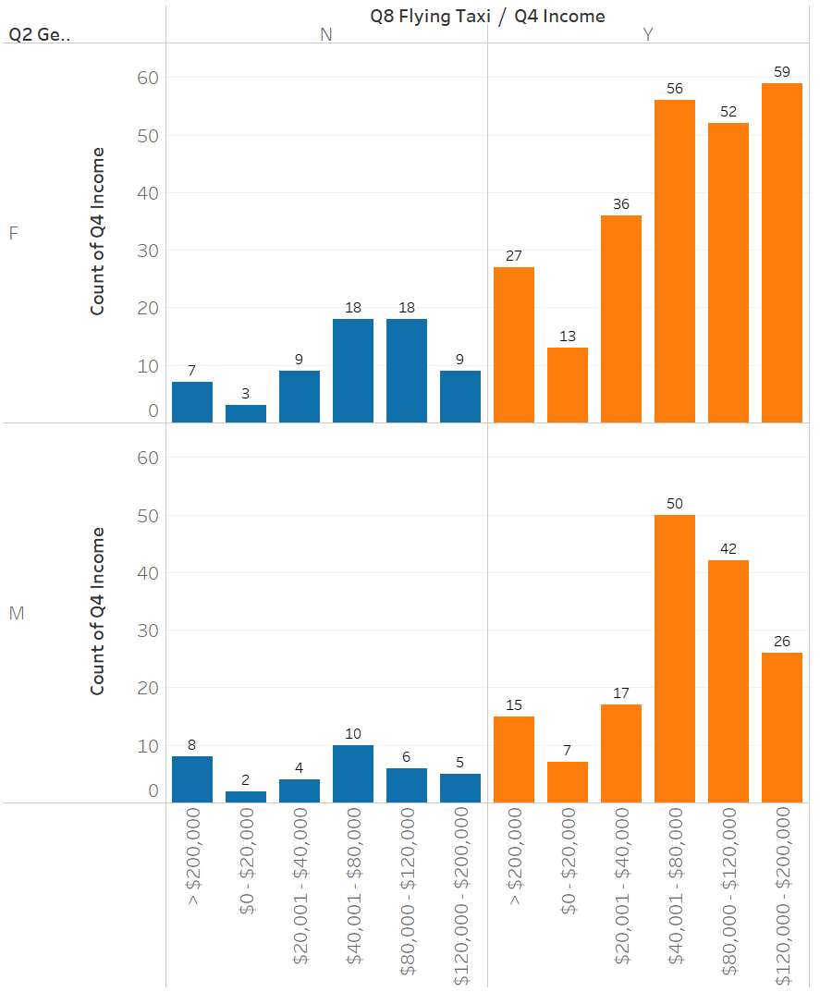
Answer Slide
Is there an inclination of better Flyber adoption based on gender, age, income level, or neighborhood of residence?
Most users surveyed favor use of flying taxis.
Overall users who would use flying taxis had higher incomes for both genders.
Users with incomes between $40,001 and $200,000 favor the use of flying taxis.

Slide 32
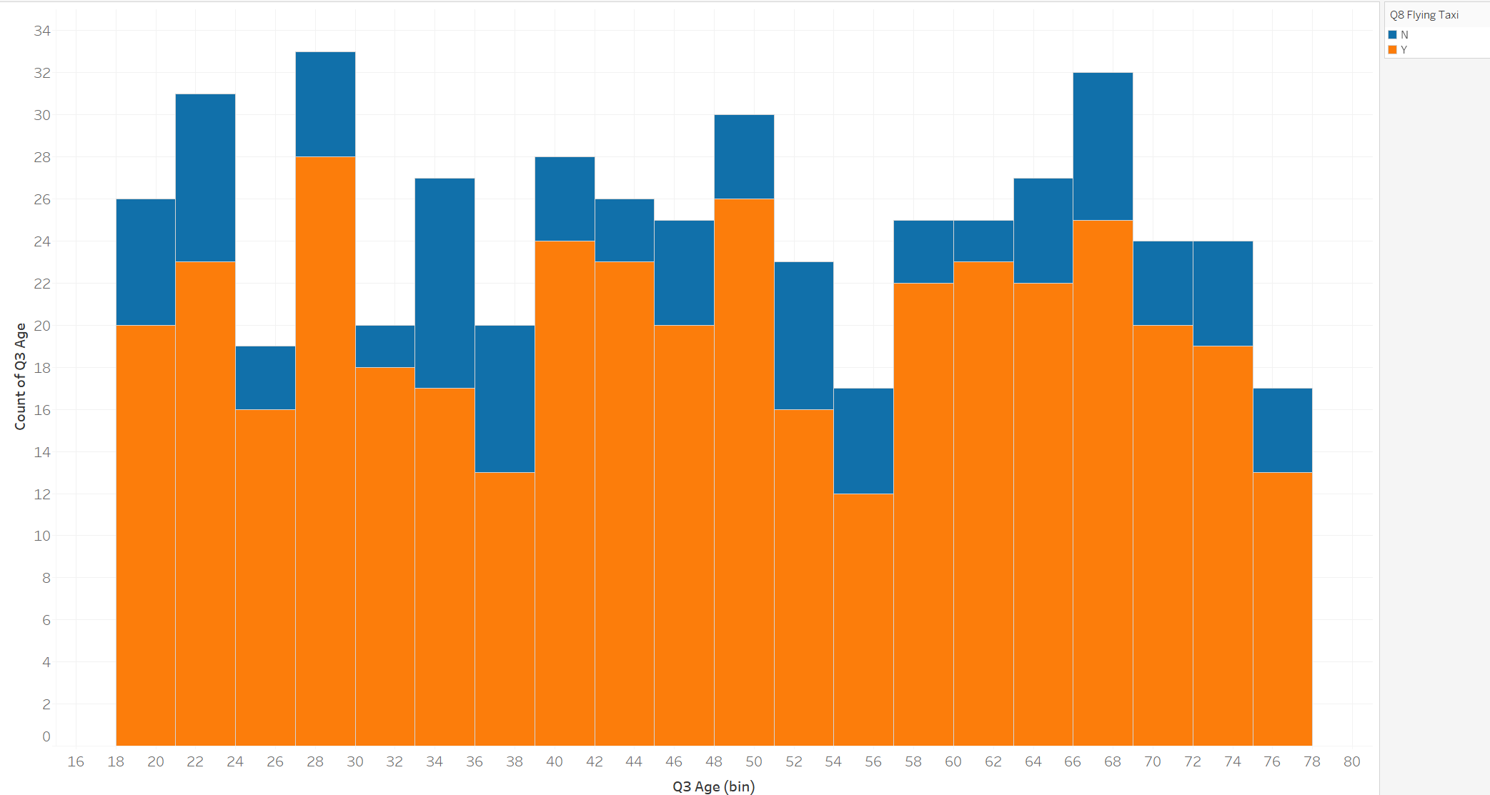
Answer Slide
Is there an inclination of better Flyber adoption based on gender, age, income level, or neighborhood of residence?
Age distributions of users with favor and disfavor flying taxis are about the same. No age disparities.

Slide 33
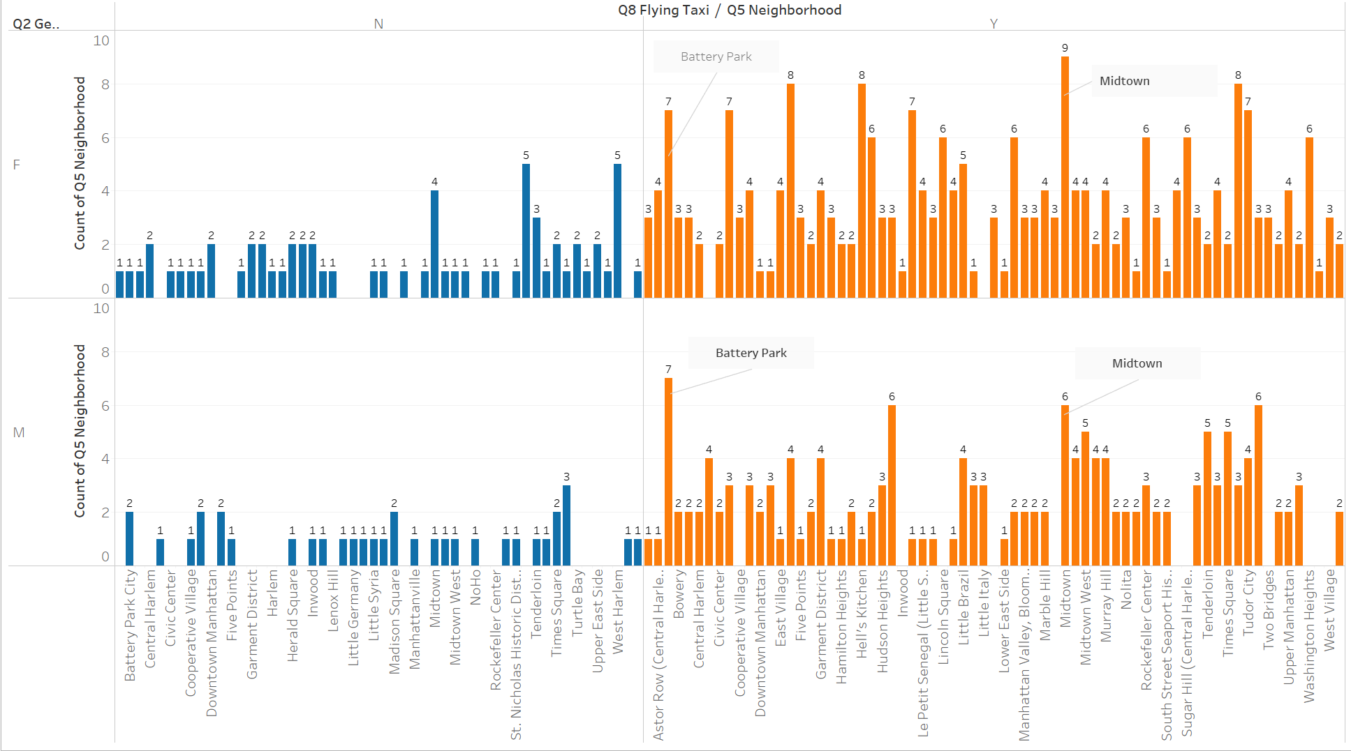
Answer Slide
Both genders in Battery Park and Midtown highly favor flying taxis.

Slide 34
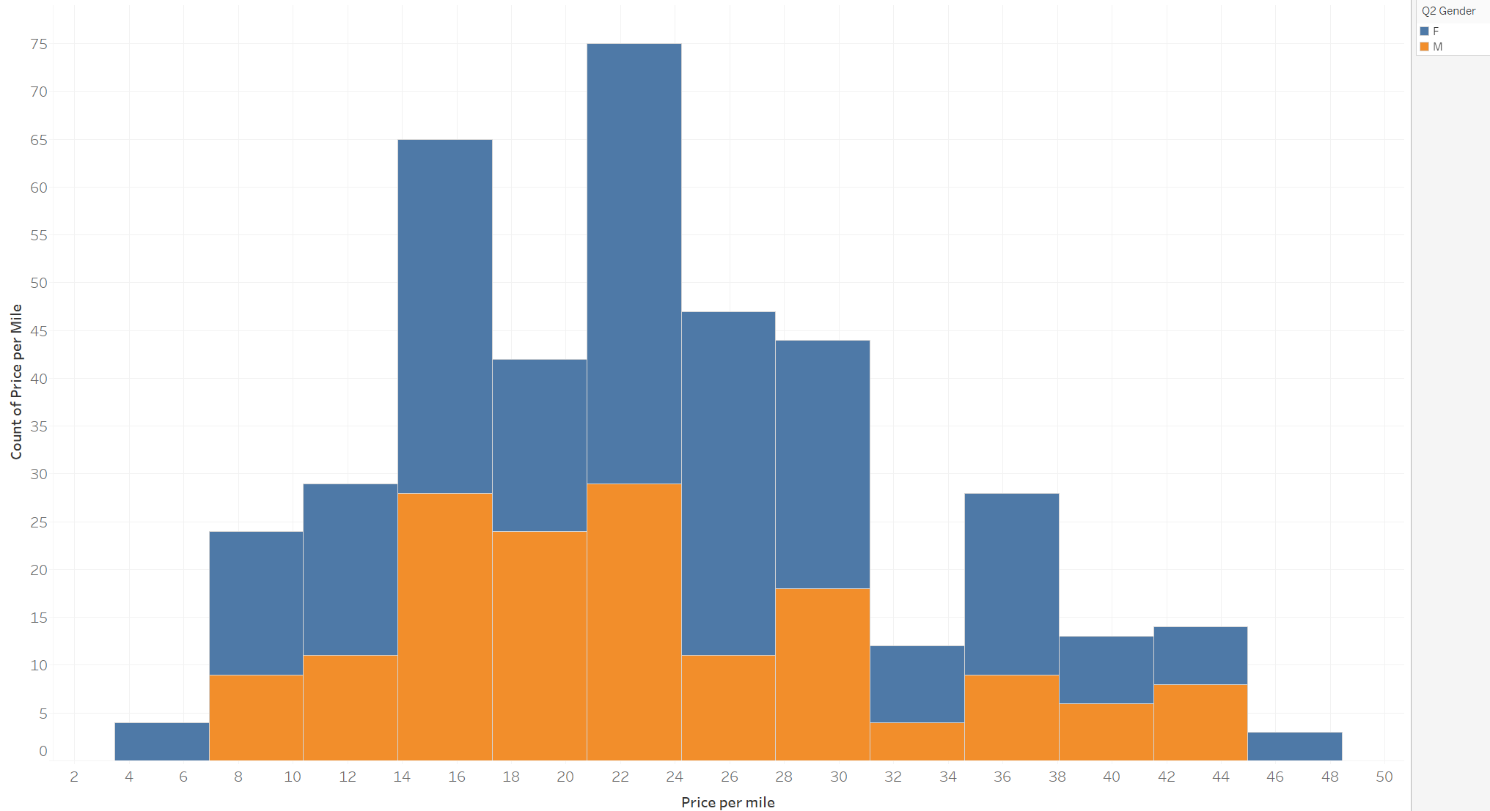
Answer Slide
What is the distribution of potential price per mile based on gender, age, income level, and neighborhood of residence?
Potential price per mile distributions of users gender are about the same. No gender disparities.

Slide 35
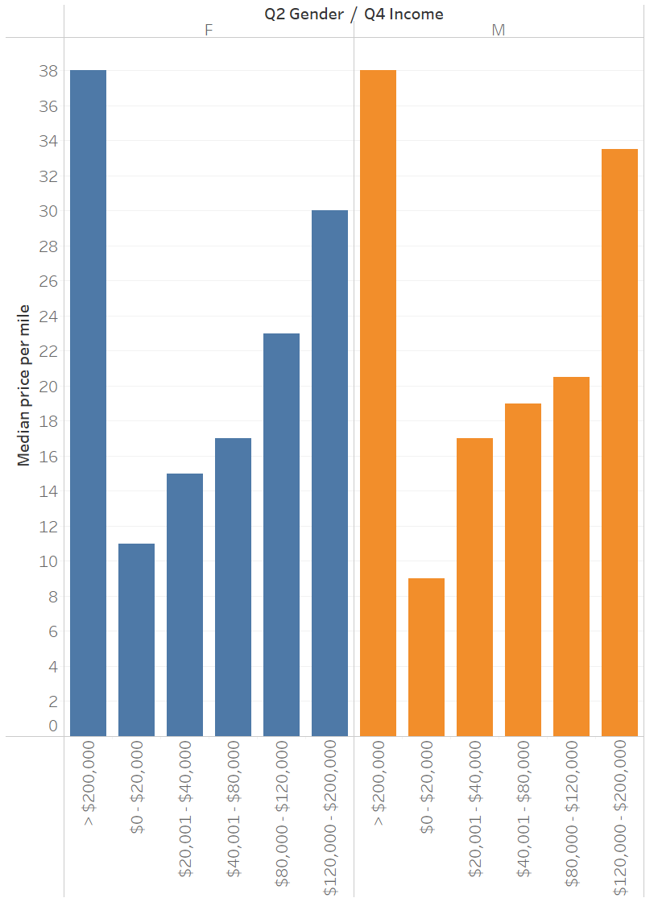
Answer Slide
Median potential price per mile increases with raising income for both genders.
Folks with higher income are willing to pay more for flying taxi fares.

Slide 36
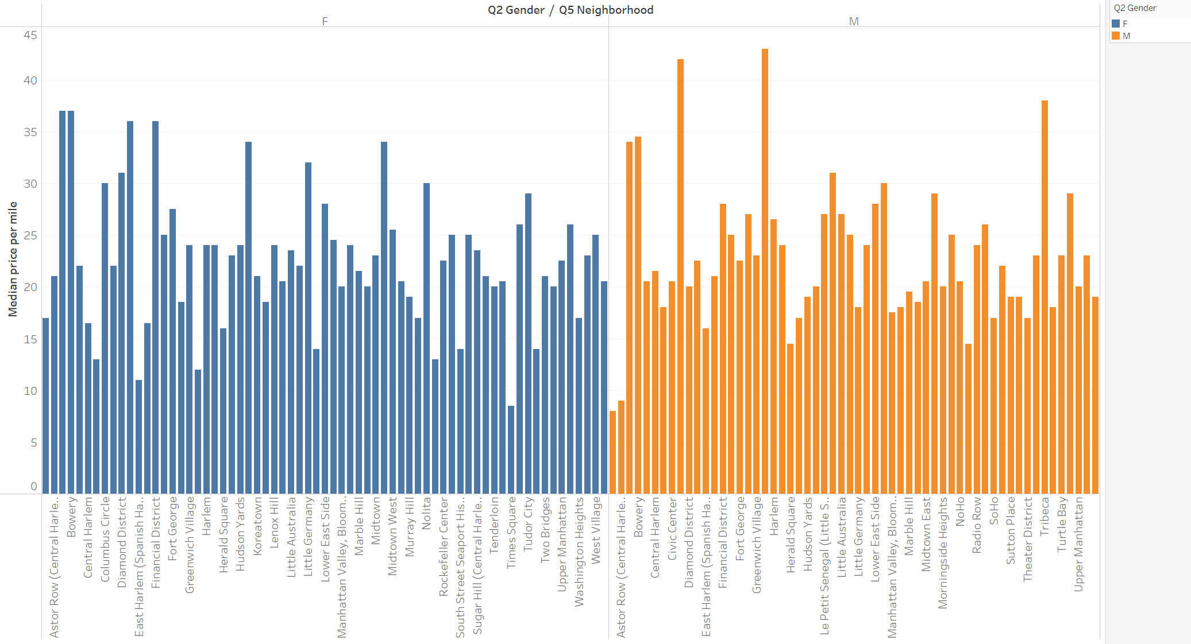
Answer Slide
Median price per mile for female users consistently peaked at $35 to $40 for users in Battery Park, Bowery, Downtown and Financial District. For male users, the top median prices are $40 to $45 for users in Columbus Circle and Hamlton Heights.

Slide 37
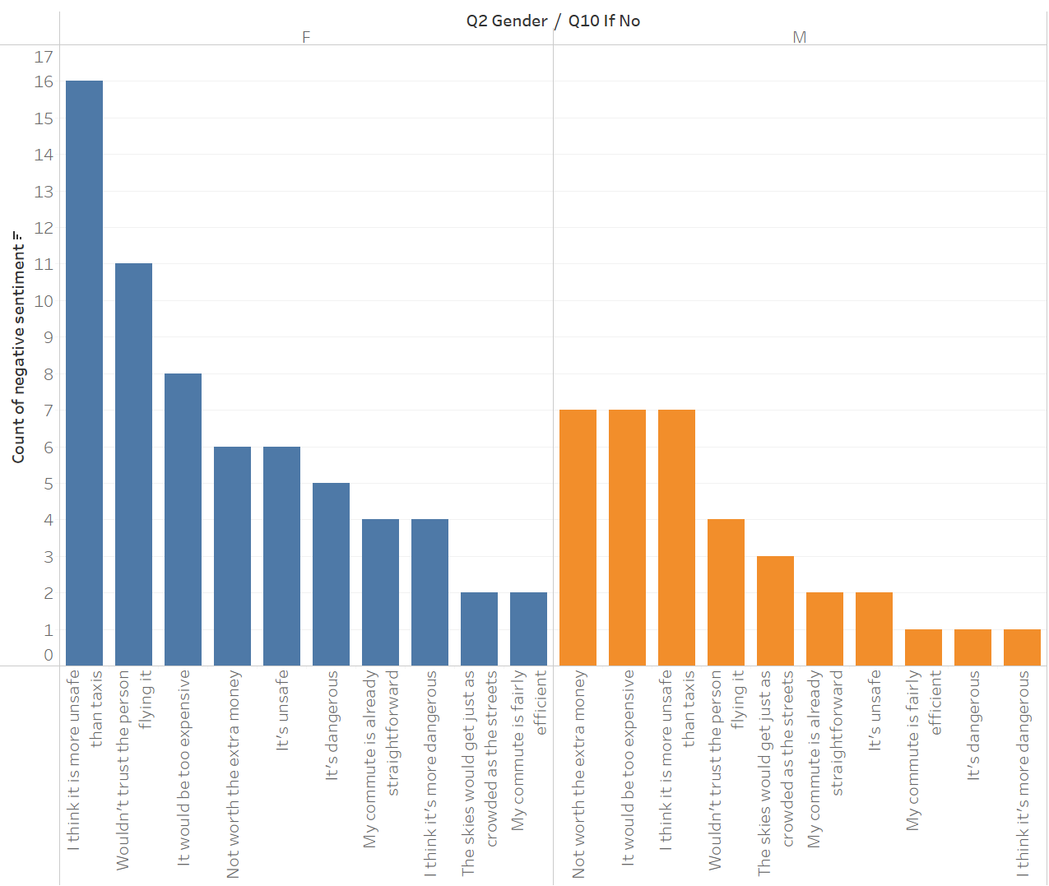
Answer Slide
What is the different personas/segments of negative sentiment towards not using a flying taxi car service?
Female users are more concerned about safety than potential expense, while male users are the opposite.

Slide 38
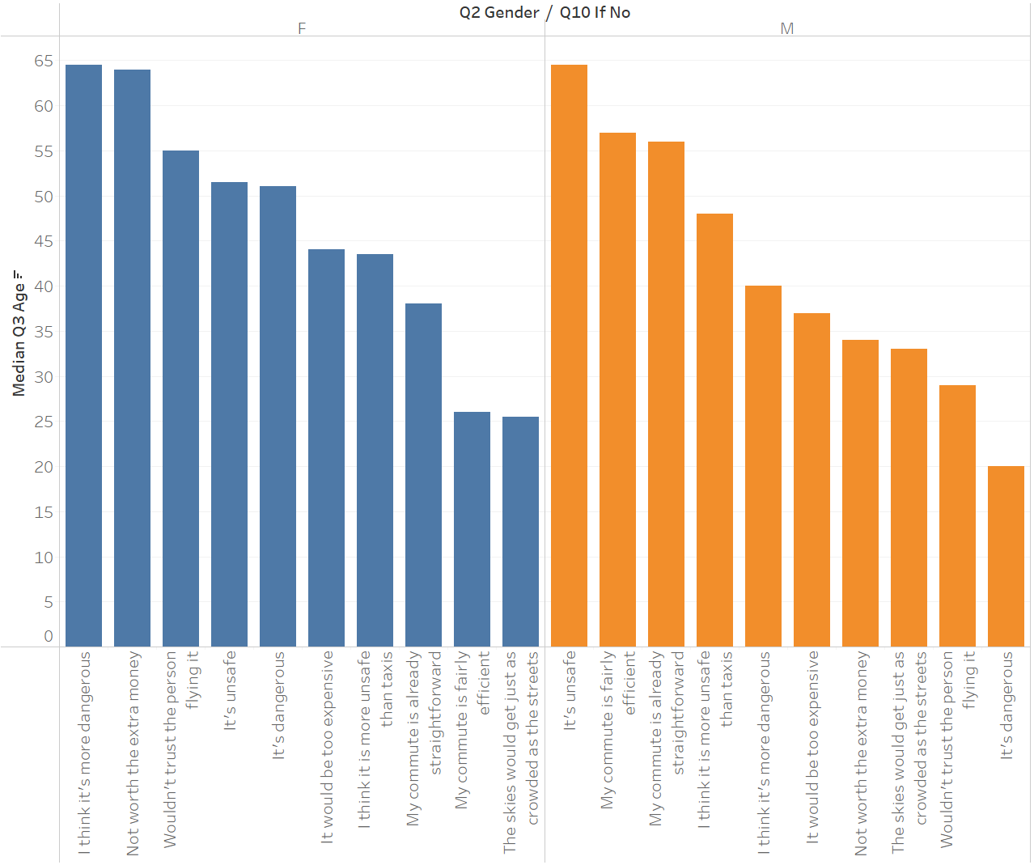
Answer Slide
Older and female users are more concerned about safety and expense, while younger female users care more about commute efficiency and concerns of congestion of the skies.
Older male users worry about safety and questions need for flying taxis while younger males have safety concerns.

Slide 39
Hooray! End of Section 1.

Slide 40
You will complete Section 2 at the end of this course.
Please submit this file for review for Section 1.

Slide 41
Section 2: Proposal Synthesis

Slide 42
Identify a product objective for Flyber's launch. Your product objective will guide your KPIs, so identify what Flyber should optimize for. Your objective should be centered around one the following focus areas:
User Acquisition
User Engagement
User Retention
Profitability
Explain your reasoning. Include both why you feel your focus area is more relevant than the others for Flyber at this time of the product development cycle.

Slide 43
Answer Slide
Product objective:
Ensure user engagement to Flyber by providing a safe and unique flying experience, building trust with users.
Compared to other areas, user acquisition, user retention and profitability, user engagement is more relevant at this stage of product development cycle.
User acquisition focuses on getting new users but if they just use Flyber one time, never to return then there is no continued business or profits.
User retention is expected once user engagement is achieved. Assuaging the fear, safety and trust concerns of users and making the flying experience a unique, exciting and enjoyable experience rather than the drudgery of traditional transportations should engage the users to return for more repeated flying taxi services. More engaged users can also provide free marketing and advertising by recommending their experience to others, capturing more new users and in turn engaging them too.
Only with repeated and consistent return users by engaging the users will there be profits.

Slide 44
Formulate 3-5 Key Performance Indicators (KPIs), to measure if the product is heading towards the right direction based on your objective

Slide 45
Answer Slide
KPI 1: Number of Flyber trips per user
KPI 2: Daily Active Users (DAU) - number of unique users on Flyber per day
KPI 3: Lness - Number of days a user has used Flyber in 30 days time frame.

Slide 46
Create hypotheses around what thresholds your KPIs would need to hit in order to determine success

Slide 47
Answer Slide
Hypothesis 1: Introduction of a status dashboard within the flying taxis to show users in realtime the status of the vehicle, altitude, flying time, wind speeds etc. to better reassure users on the safety of the flying taxis will increase number of trips per users by 50%.
Hypothesis 2: Introduction of a 30 days promotional campaign where users buying one trip get return trip free increases the Daily Active Users (DAU) by 50%.
Hypothesis 3: Adding reservation feature on the app increases Lness by 25% as users can better plan and schedule their day.

Slide 48
As the product manager, you make decisions based on the insights you extract, we’ll need to know the feature set we’ll include in the MVP to measure viability, while keeping operational expenditure under control:
What times/days of operation should the service run for?
How many pick-up / drop-off nodes should we have?
Where should the nodes be located?
Should we initially use copters or homegrown hardware?
Should the pricing be fixed or dynamic? At what rates?

Slide 49
Answer Slide
What times/days of operation should the service run for?
First start with services Thurs, Fri and Sat which are highest volume for the week. Focusing on 5pm to 11pm.
Once the early kinks have been worked out, can expand to more days and hours.
Refer to slide 26.
How many pick-up / drop-off nodes should we have?
3 nodes.
Where should the nodes be located?
One each in JFK and LGA airports due to consistent high volume at with airplane travelers. One in middle of Manhanttan due to the central locality that is close to the users’ final destinations.
Refer to slide 24.
Should we initially use copters or homegrown hardware?
As first MVP, some customized copters should be used to speed up start of service and as revenue and profits come in, they can be invested to develop more homegrown hardware.
Should the pricing be fixed or dynamic? At what rates?
Given the initial limited service period, pricing should be fixed at median price of $23. As the service expands, pricing can becomes dynamic based on demand, $30 to 40 from 5pm to 11pm, $20 to $30 from 7am to 5pm, and $10 to $20 from midnight to 6am.
Refer to slide 35.

Slide 50
Determine the MVP sample size & time period allotted estimated to come to a conclusion on your hypotheses.

Slide 51
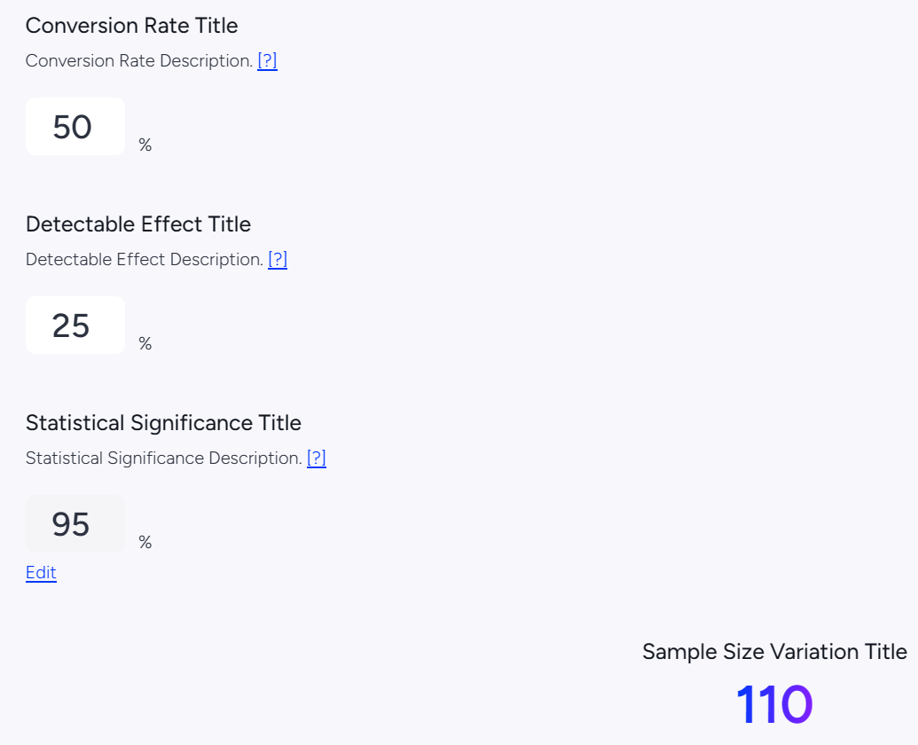
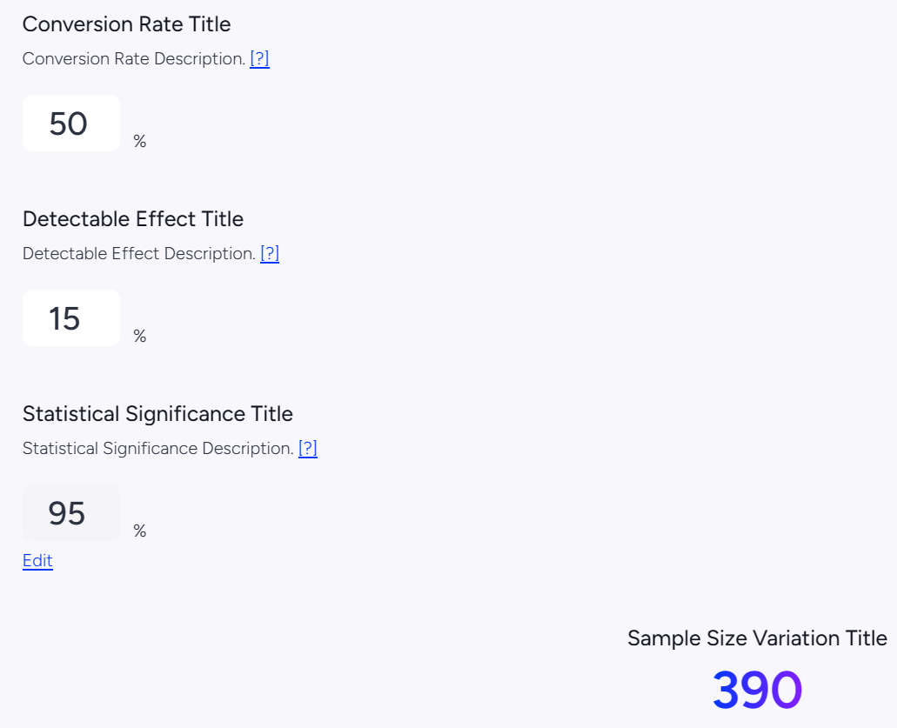
Answer Slide
Hypothesis 1: Introduction of a status dashboard within the flying taxis to show users in realtime the status of the vehicle, altitude, flying time, wind speeds etc. to better reassure users on the safety of the flying taxis will increase number of trips per users by 50%.
50% conversion rate | 25% detectable effect | 95% statistical significance
110 sample size
Estimate duration 30 days, adjustable based on existing usage.
Hypothesis 2: Introduction of a 30 days promotional campaign where users buying one trip get return trip free increases the Daily Active Users (DAU) by 50%.
50% conversion rate | 15% detectable effect | 95% statistical significance
390 sample size
Duration 30 days
Lower detectable effect as promotional campaign will eat into profits.

Slide 52
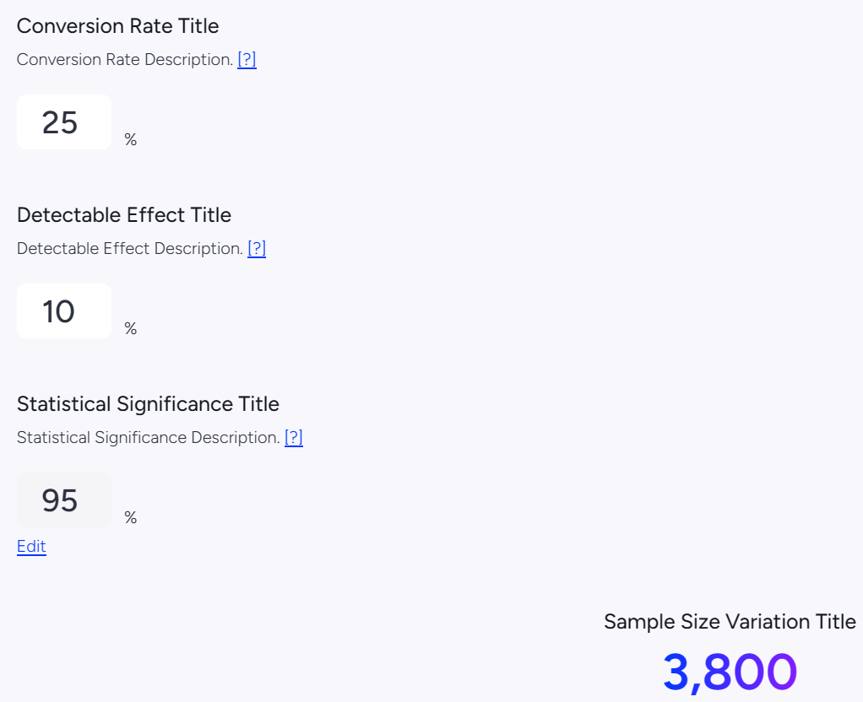
Answer Slide
Hypothesis 3: Adding reservation feature on the app increases Lness by 25% as users can better plan and schedule their day.
25% conversion rate | 10% detectable effect | 95% statistical significance
3800 sample size
Estimate duration 30 days, adjustable based on existing usage.

Slide 53
Create an instrumentation plan for the events you need collected and logged, in order to be able to physically measure your KPIs.

Slide 54
Answer Slide
KPI 1: Number of Flyber trips per user
Event is when user boards the flying taxi via a QR code scan (like boarding pass).
Event Properties: user_id, user_boarded, pickup_datetimestamp, pickup_location
KPI 2: Daily Active Users (DAU) - number of unique users on Flyber per day
Event is when user boards the flying taxi via a QR code scan (like boarding pass).
Event Properties: user_id, user_boarded, pickup_datetimestamp, pickup_location
Event is if a discount code is used.
Event Properties: user_id, discount_code
KPI 3: Lness - Number of days a user has used Flyber in 30 days time frame.
Event is when user boards the flying taxi via a QR code scan (like boarding pass).
Event Properties: user_id, user_boarded, pickup_datetimestamp, pickup_location
Event is when reservation is made on app or website after login.
Event Properties: user_id, reservation_datetimestamp, pickup_location, pickup_datetimestamp

Slide 55
Create a qualitative feedback survey questions for users after their ride, to further understand and optimize the product for future iterations.

Slide 56
Answer Slide
Did you have any issues with the app or website?
Did you have any issues with the flying taxi?
Is Flyber your first choice for this trip? If not, what is?
Would you ride again with Flyber? If not, why?
Would you recommend Flyber to your friends and family? If not, why?

Slide 57
Summarize everything you have learned into your final proposal
Identify the target population. Why did you select that target population? What are their pain points?
Create a product proposal containing claim, evidence, estimated impact, and risks
Claims should be backed by quantitative evidence, impact should assess market needs/benefits
Risks involve any known unknowns that we’ll still need to monitor post-launch
State cross-functional stakeholder teams that will need to be involved

Slide 58
Answer Slide
Identify the target population. Why did you select that target population? What are their pain points?
1 to 2 passengers as traditional taxis mostly transport 1 or 2 people
Users traveling between JFK and LGA to middle of Manhattan which is centrally located as these are the consistently high volume locations.
Target income between $40,001 to $200,000 who favor flying taxis and are willing to pay higher premiums for the service.
Pain points are the longer transit times from ground transportation due to traffic congestions, road closures, poor comfort due to poor road quality, cost fluctuations based on demand, potential safety issues due to lack of licensing and regulatory rigor.

Slide 59
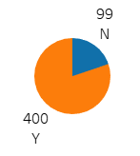
Answer Slide
Create a product proposal containing claim, evidence, estimated impact, and risks
Claim: To avoid longer transit times from ground transportation, users are willing to pay a premium for a flying taxi service.
Evidence: Of 499 respondents, 400 were willing to use a flying taxi service, paying a median of $23. Higher incomers are willing to pay even more, up to $38.
Estimated impacts
User impact: Increase user wellbeing (reduced stress and increase enjoyment from the ride).
Market impact: Reduce traffic congestion, less wear on road and less costs spent on repairs
Business impact: Expand use of roadway for pedestrians and shops for higher commerce from foot traffic.
Risks: Regulatory assurance and certifications for safety, expensive equipment, very skilled pilots.

Slide 60
Answer Slide
State cross-functional stakeholder teams that will need to be involved
Regulatory for compliance with federal and state laws on air transportation.
Legal for compliance with federal and state laws on air transportation, consumer laws like terms of use and user agreements.
Vehicle Engineering for engineering ISO standards for flying taxis
Software Engineering for platform development and maintenance (website, apps, backend)
Data and AI for data science and machine learning of data for optimization.
Quality for testing of hardware and software for safety and reliability.
Product Management for organizing and facilitating the progress of project.
Finance for managing costs, revenue, profit, runways.
Customer Service for managing customers.

